Slide 1





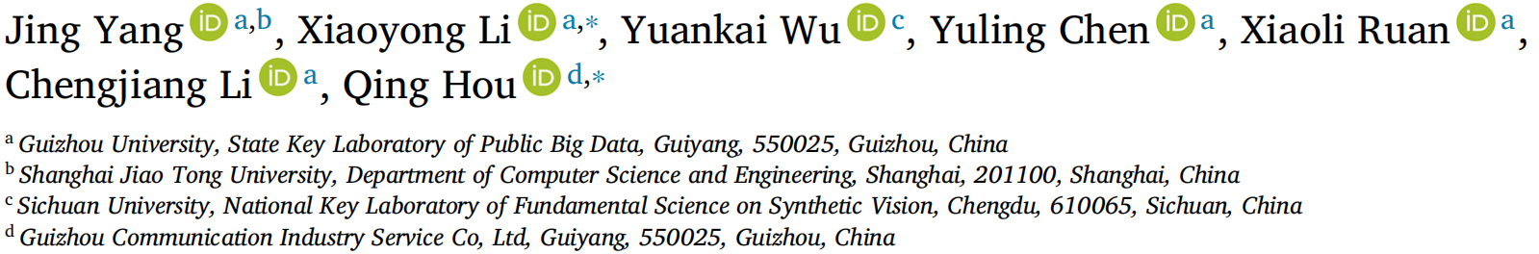





ATAI
Advanced Techniqueof Artificial Intelligence
ATAI
ChongqingUniversity _{AdvancedTechniqueof}
of Technology Artificial Intelligence
Chongqing University of
Technology
Chongqing University ^{ATAI}
_{of Technology} Advanced Techniqueof
Artificial Intelligence
Chongqing University of Technology
Chongqing University of Technology
Self-attention and cross-modal attention for audio-visual zero-shot learning
Code: https://github.com/ybyangjing/SACMA
2025.12.24
—— IF_2026
Reported by Yang Hu
1

Slide 2

ATAI
AdvancedTechniqueof
Artificial Intelligence
ATAI
ChongqingUniversity _{AdvancedTechniqueof}
of Technology Artificial Intelligence
ChongqingUniversity of Technology
Motivation
1.The existing embedding and generation methods do not fully extract the internal features of each modality.
2.There is insufficient information interaction between different modalities.

Slide 3

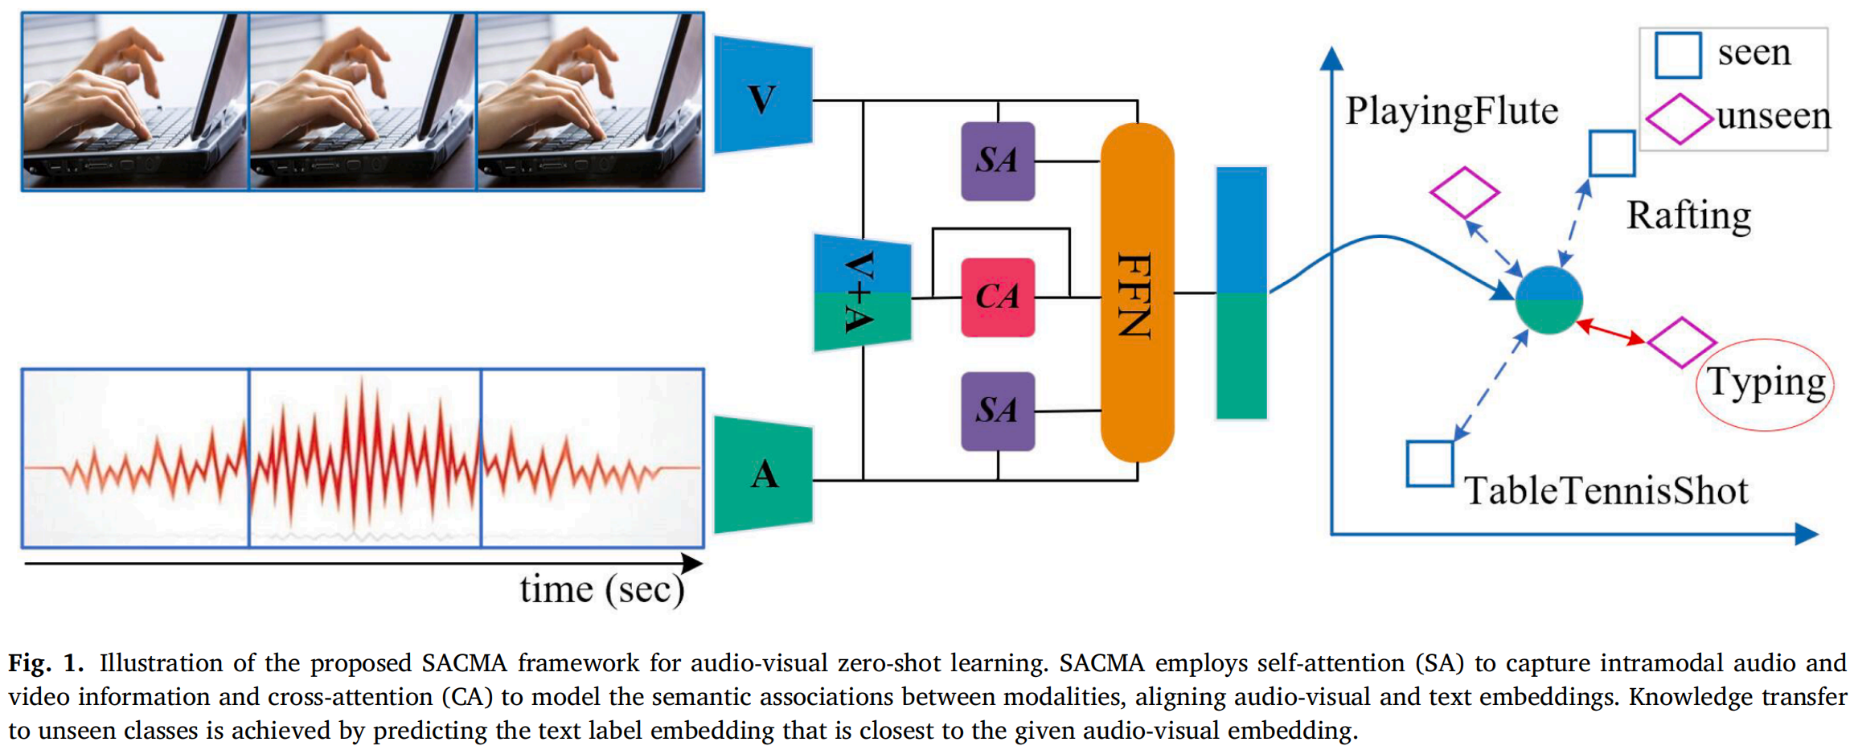
ChongqingUniversity of Technology
ATAI
AdvancedTechniqueof
Artificial Intelligence
ATAI
ChongqingUniversity _{AdvancedTechniqueof}
of Technology Artificial Intelligence
Overview

Slide 4
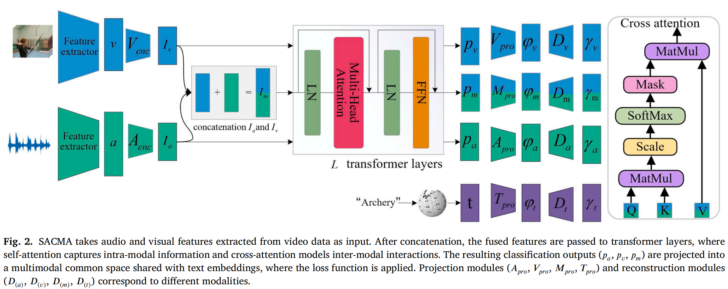
ChongqingUniversity of Technology
ATAI
AdvancedTechniqueof
Artificial Intelligence
ATAI
ChongqingUniversity _{AdvancedTechniqueof}
of Technology Artificial Intelligence
Overview

Slide 5
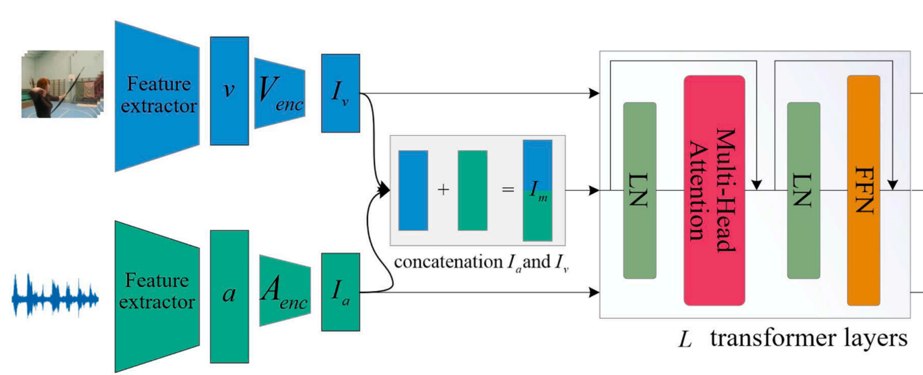
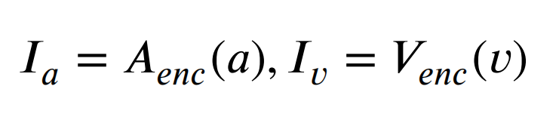
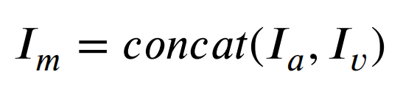
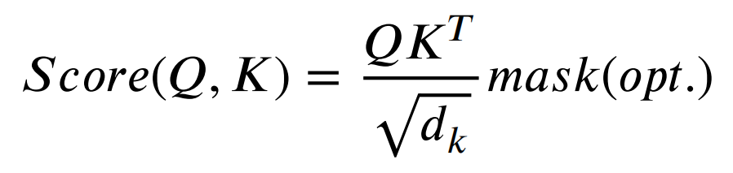
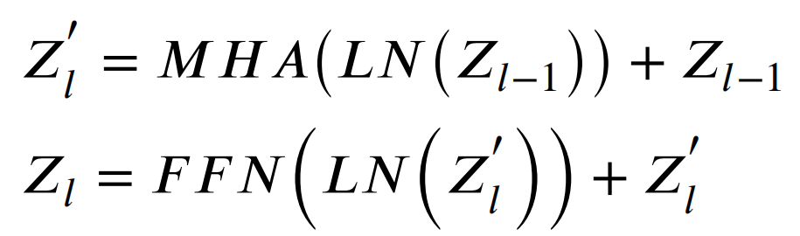
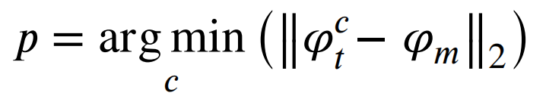
ChongqingUniversity of Technology
ATAI
AdvancedTechniqueof
Artificial Intelligence
ATAI
ChongqingUniversity _{AdvancedTechniqueof}
of Technology Artificial Intelligence
Method
(1)
(2)
(3)
(4)
(5)
(6)
(7)

Slide 6
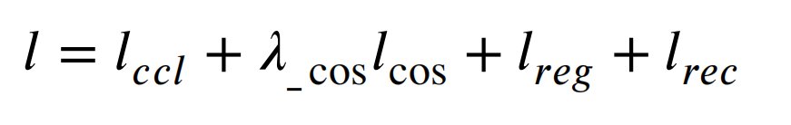
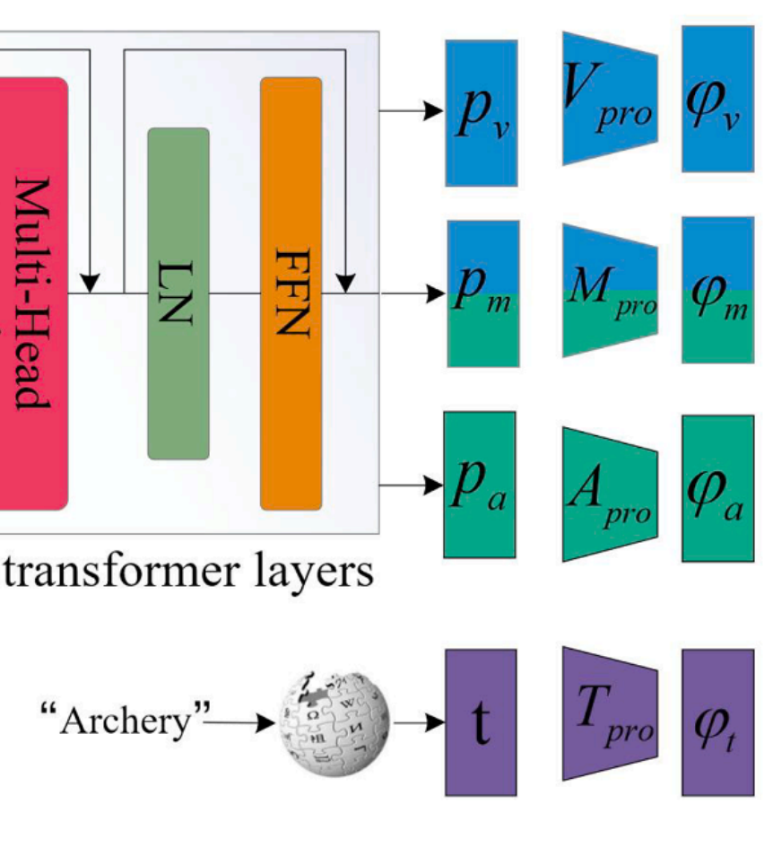
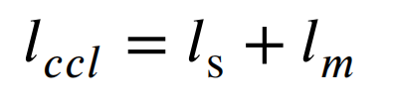
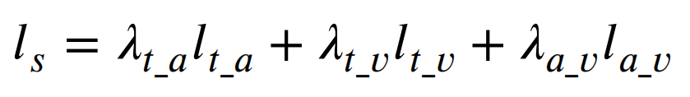
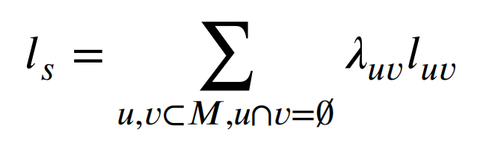

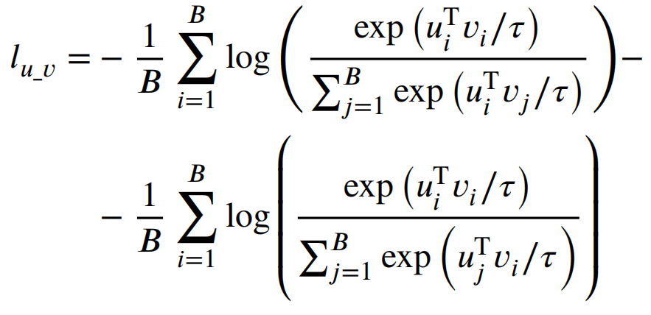
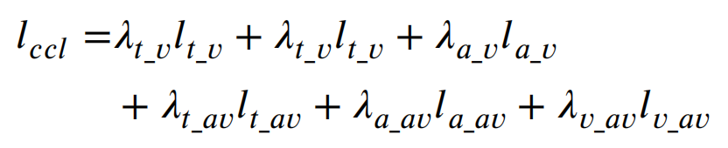
ChongqingUniversity of Technology
ATAI
AdvancedTechniqueof
Artificial Intelligence
ATAI
ChongqingUniversity _{AdvancedTechniqueof}
of Technology Artificial Intelligence
(8)
(9)
(10)
(11)
(12)
a
a
(13)
(14)

Slide 7
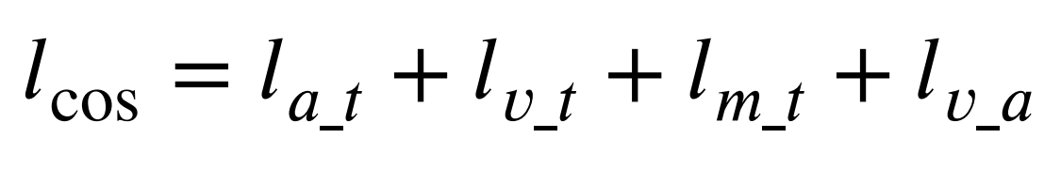
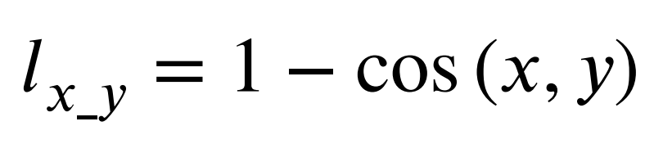
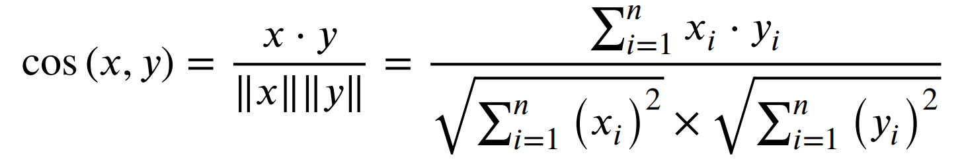
ChongqingUniversity of Technology
ATAI
AdvancedTechniqueof
Artificial Intelligence
ATAI
ChongqingUniversity _{AdvancedTechniqueof}
of Technology Artificial Intelligence
Method
(8)
(15)
(16)
(17)

Slide 8
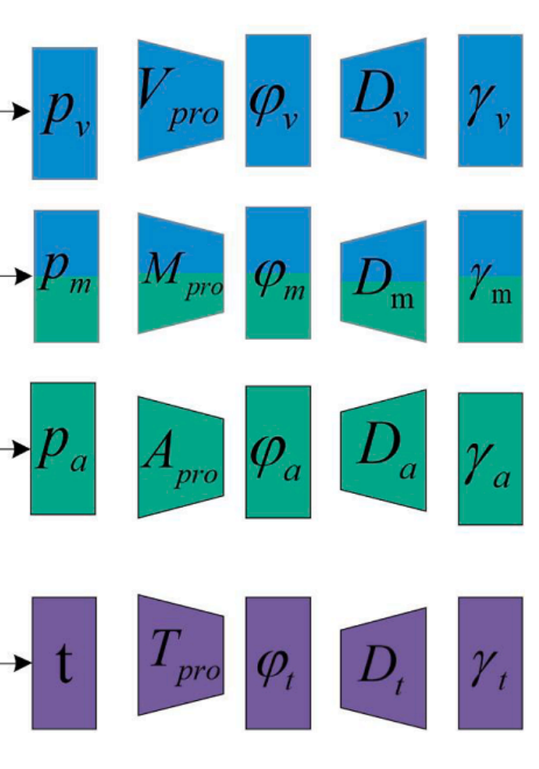
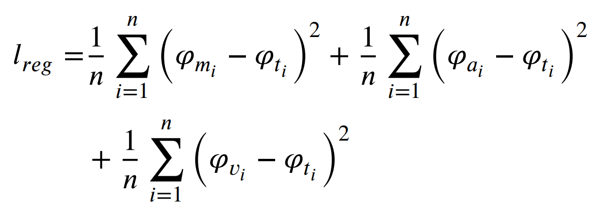
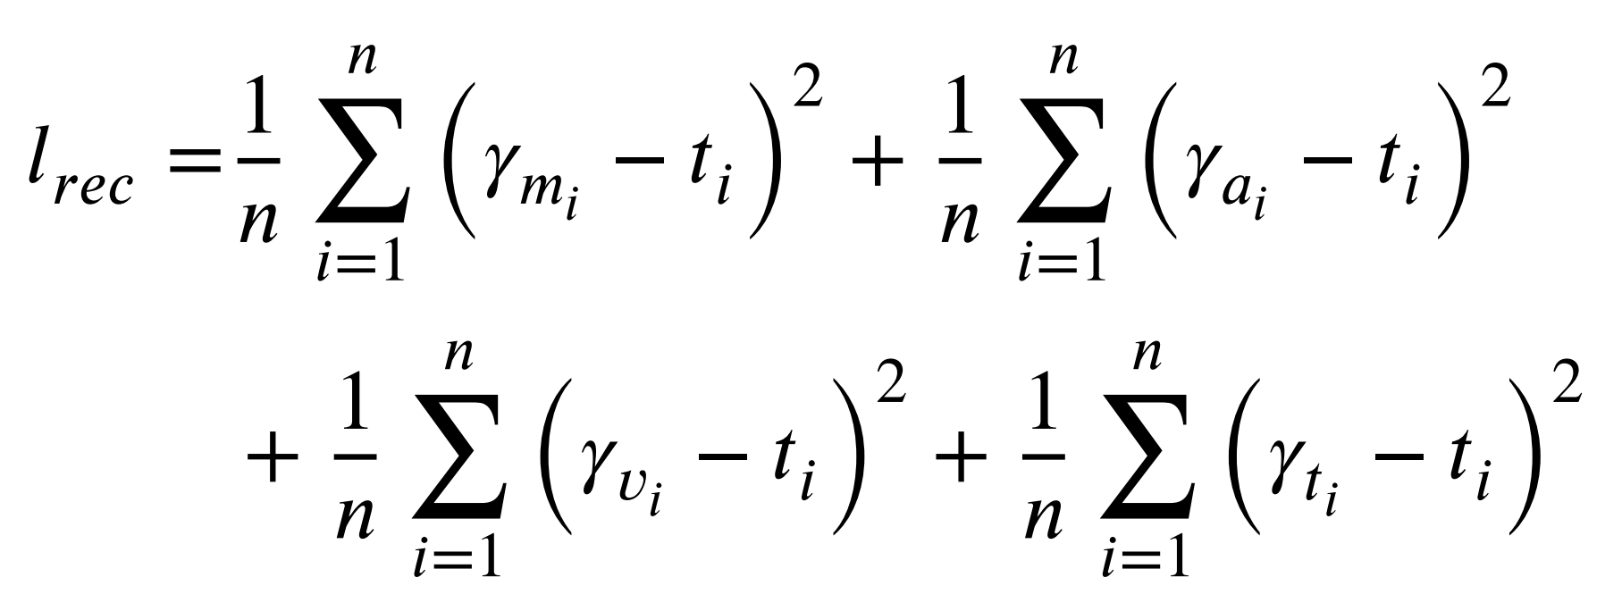
ChongqingUniversity of Technology
ATAI
AdvancedTechniqueof
Artificial Intelligence
ATAI
ChongqingUniversity _{AdvancedTechniqueof}
of Technology Artificial Intelligence
Method
(8)
(18)
(19)

Slide 9

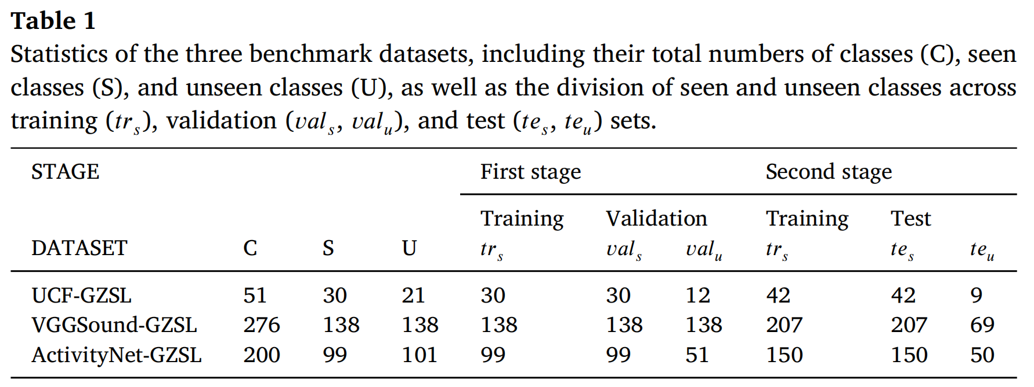
ATAI
AdvancedTechniqueof
Artificial Intelligence
ATAI
ChongqingUniversity _{AdvancedTechniqueof}
of Technology Artificial Intelligence
ChongqingUniversity of Technology
Experiments

Slide 10
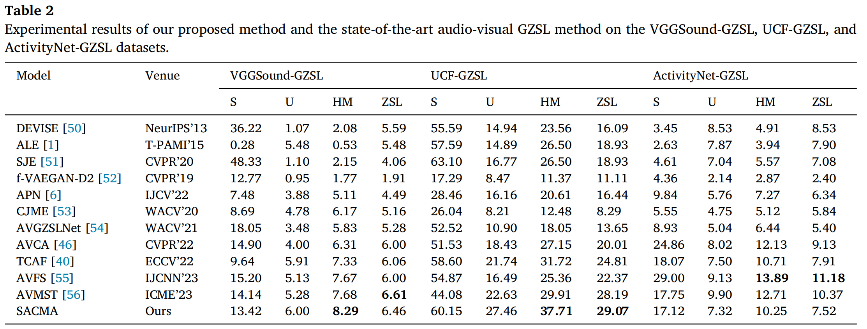
ATAI
AdvancedTechniqueof
Artificial Intelligence
ATAI
ChongqingUniversity _{AdvancedTechniqueof}
of Technology Artificial Intelligence
ChongqingUniversity of Technology
Experiments

Slide 11
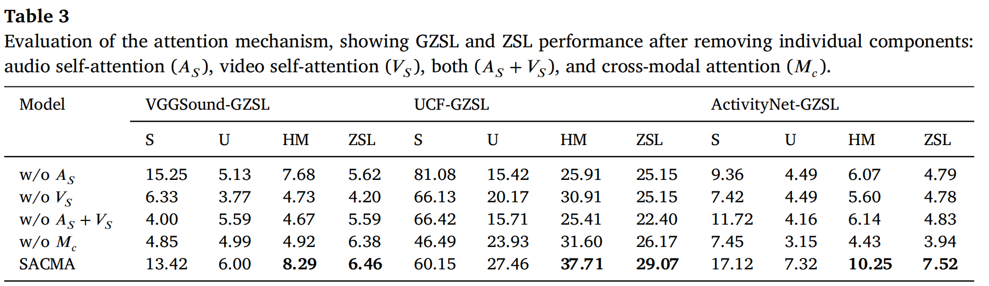
ATAI
AdvancedTechniqueof
Artificial Intelligence
ATAI
ChongqingUniversity _{AdvancedTechniqueof}
of Technology Artificial Intelligence
ChongqingUniversity of Technology
Experiments

Slide 12
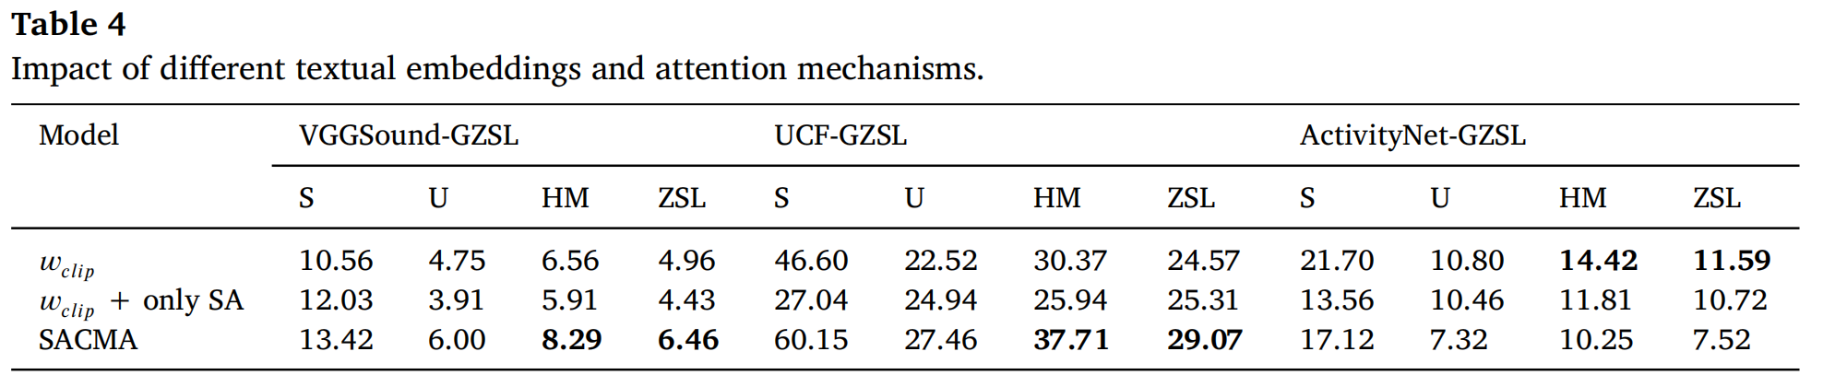
ATAI
AdvancedTechniqueof
Artificial Intelligence
ATAI
ChongqingUniversity _{AdvancedTechniqueof}
of Technology Artificial Intelligence
ChongqingUniversity of Technology
Experiments

Slide 13
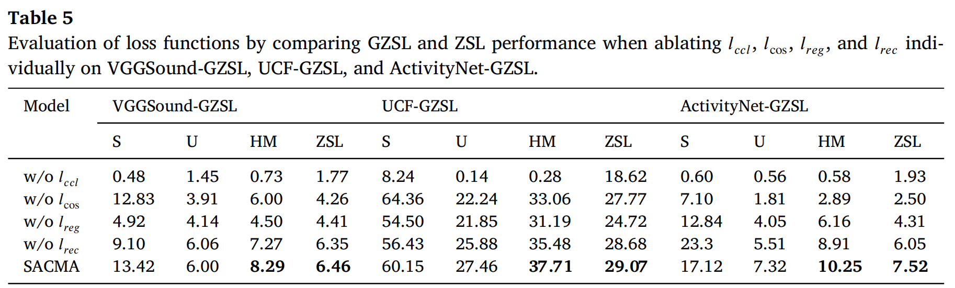
ATAI
AdvancedTechniqueof
Artificial Intelligence
ATAI
ChongqingUniversity _{AdvancedTechniqueof}
of Technology Artificial Intelligence
ChongqingUniversity of Technology
Experiments

Slide 14
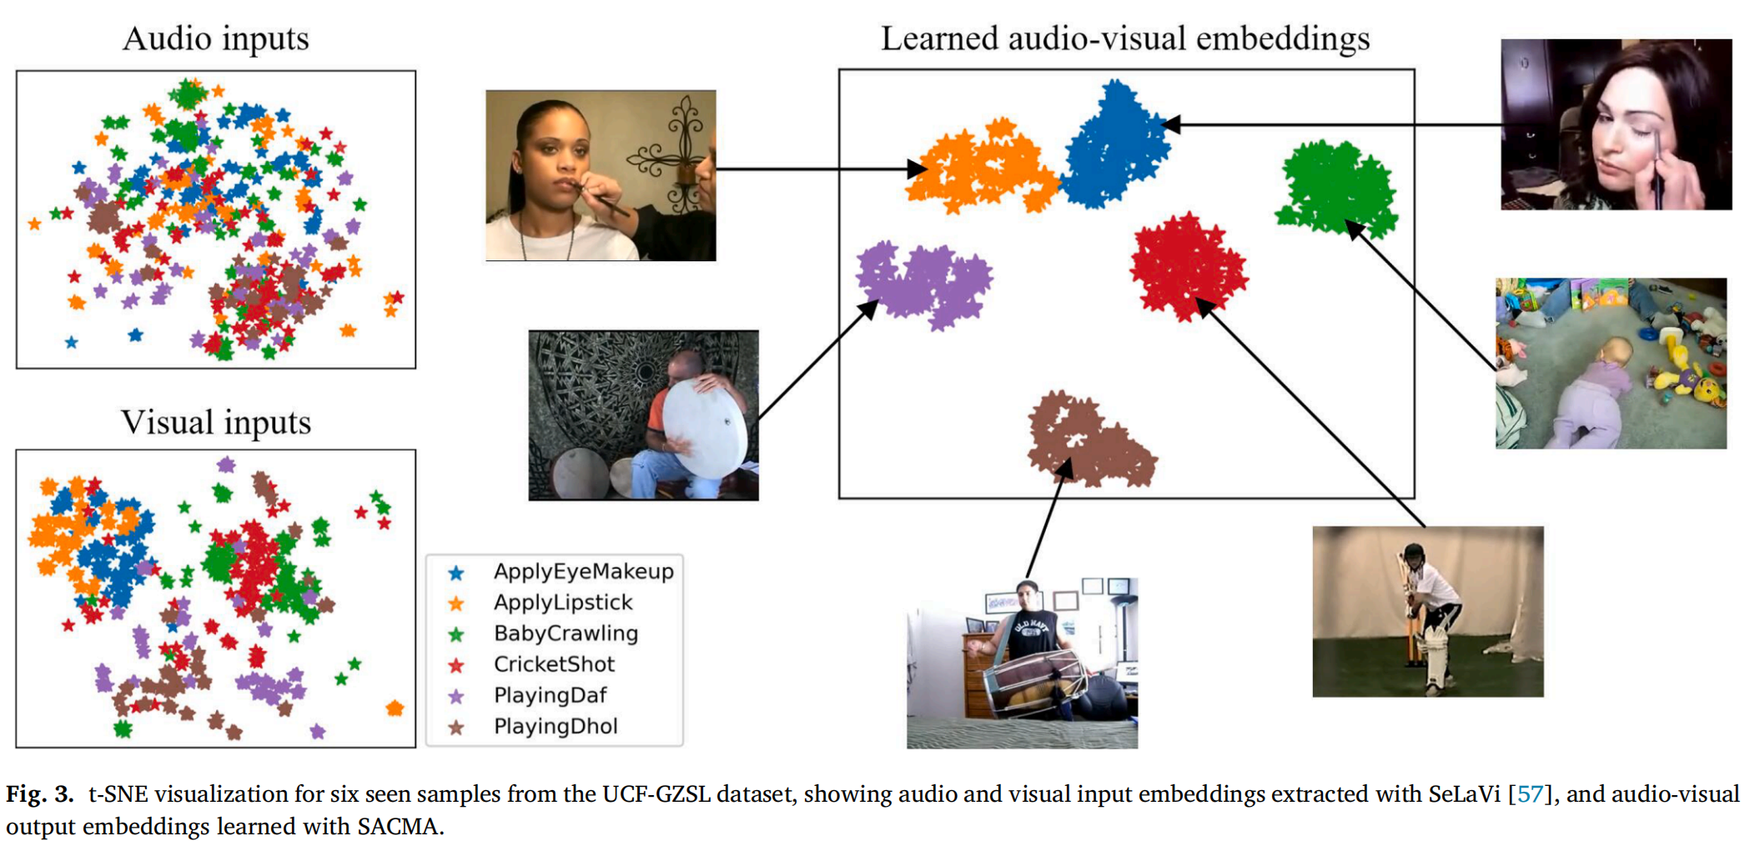
ATAI
AdvancedTechniqueof
Artificial Intelligence
ATAI
ChongqingUniversity _{AdvancedTechniqueof}
of Technology Artificial Intelligence
ChongqingUniversity of Technology
Experiments

Slide 15
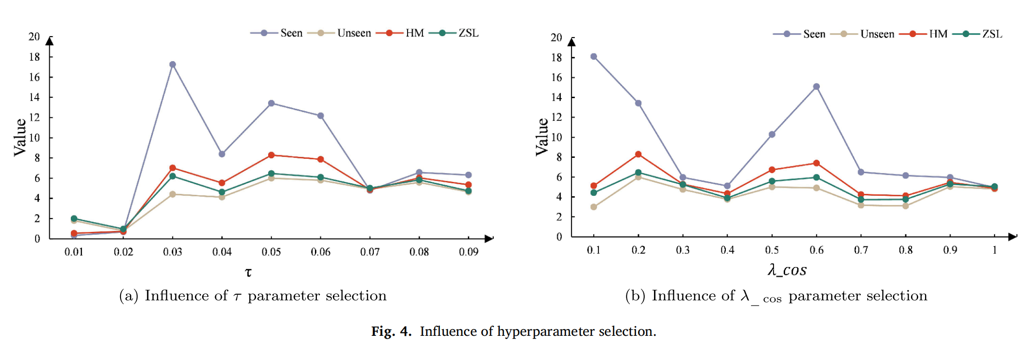
ATAI
AdvancedTechniqueof
Artificial Intelligence
ATAI
ChongqingUniversity _{AdvancedTechniqueof}
of Technology Artificial Intelligence
ChongqingUniversity of Technology
Experiments

Slide 16
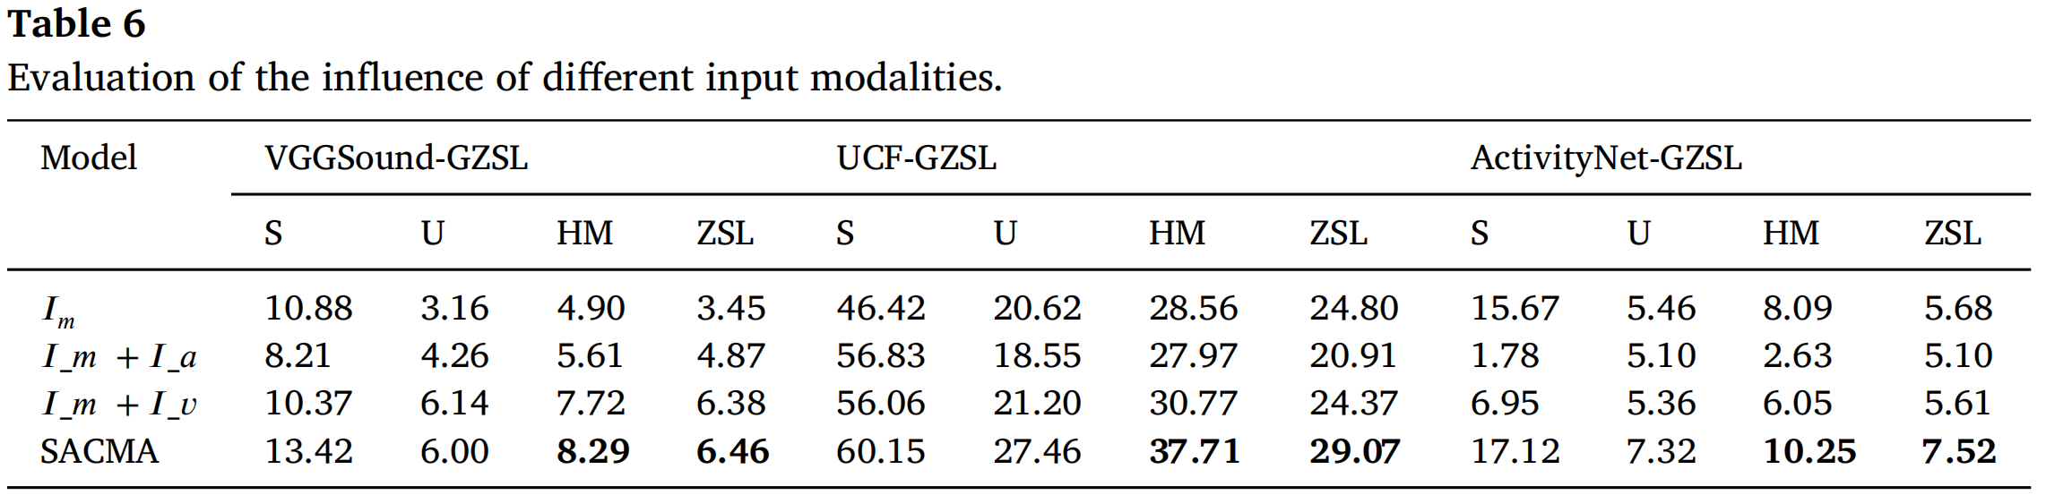
ATAI
AdvancedTechniqueof
Artificial Intelligence
ATAI
ChongqingUniversity _{AdvancedTechniqueof}
of Technology Artificial Intelligence
ChongqingUniversity of Technology
Experiments

Slide 17
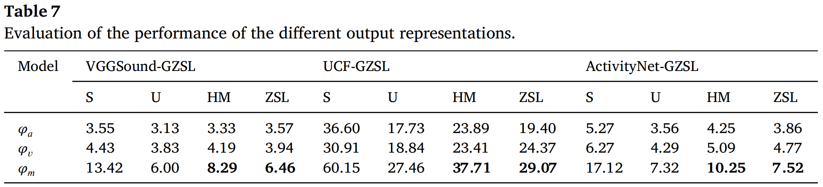
ATAI
AdvancedTechniqueof
Artificial Intelligence
ATAI
ChongqingUniversity _{AdvancedTechniqueof}
of Technology Artificial Intelligence
ChongqingUniversity of Technology
Experiments

Slide 18


ChongqingUniversity of Technology
ATAI
AdvancedTechniqueof
Artificial Intelligence
ATAI
ChongqingUniversity _{AdvancedTechniqueof}
of Technology Artificial Intelligence
Thanks!

